Slide 1
American Society of Naval Engineers - Tidewater Section Dinner
VADM David H. Lewis, USN
19 February 20
Unclassified//For Official Use Only

Slide 2

Agenda
DCMA 101
DCMA vs DCAA
DIB
CMMC

Slide 3
Defense Acquisition Community
Secretary of Defense
Under Secretary of Defense
(Acquisition & Sustainment)
Chairman
Joint Chiefs of Staff
Buying Commands
Defense Contract Management Agency
Army
Combat Support Agency
Navy
Air Force
Marines
Defense Logistics
Agency
Contract Administration

Slide 4
DCMA Chartered Mission (DoD Directive 5105.64)
“Mission: DCMA performs Contract Administration Services (CAS) for DoD, other authorized Fed Agencies, foreign gov’ts, int’l organizations, and others as authorized.
  Specific guidance on roles and responsibilities for contract administration and management outlined in FAR 42.302 and DFARS 242.302
  Predominant workload delegations are on major production type contracts. Other type contracts delegations accepted on case by case basis.
  Exceptions where contract administration is generally retained by the military services include:
      SUPSHIPS contracts
      Office of Naval Research contracts
      Ammunition contracts
      Army Corps of Engineer contracts and most facilities type contracts
      “Post, Camp, and Station” contracts
Notes:
What we do and don’t do– DCMA has various capabilities ( i.e. quality control, business systems, CPSR, small business, cost & pricing, etc…)

Slide 5
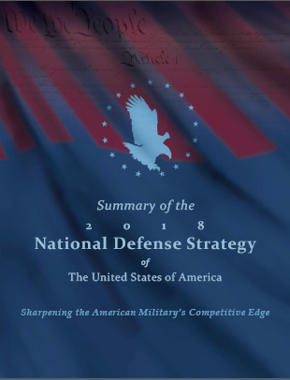
DCMA Alignment to the SECDEF Priorities

Support to the Warfighter
  Enhanced product delivery for lethality and readiness
  Increased Affordability
Support to our Allies
  Foreign Military Sales
  International Presence
Business Reforms
  Commercial Items
  Canceling Funds



Slide 6
Scope of Work and Span of Control
Scope of Work
Span of Control
Total Contract Amount | $5.2 trillion
Obligated Amount | $2.111 trillion
Serviced Contractor Locations | 19,355
Active Contracts | 348,866
Contract Unliquidated Obligations | $288.4 billion
ACAT I (IAC, IC, ID) & II Programs | 188
Aircraft Accepted (FY18) | 1,136
Aircraft Acceptance Flying Hours (FY17) | 15,025
Oversight of Government Property | $152.5 billion
Progress Payments | $19.4 billion
Performance-based Payments | $12.5 billion
Total Workforce | 12,193
Civilian | 11,641
Military (Active Duty – 375, Reserve – 177) | 552
Budget Authority | $1.4599 billion
Reimbursable Target | $238.9 million
DCMA authorize $678.4 million in contractor payments
per business day.
1QFY19 data
Notes:
Total Contract Amount: Issue experienced at end of 1st Qtr FY19. Total Contract Value was in database at $10.986T – more than double identified in 4 Q FY18.
Research with FIRM indicated that 1150 IDIQ Navy contracts were entered in MOCAS in December 2018, each for $5B. Total amount equals $5.75T. FIRM analysts believe this is cause for the significant increase in total contract value.
When the IDIQ contract total value is removed from the $10.986T, the revised/corrected value equals $5.2T, which is comparable to the 4Q FY18 value of $5.1T. The $5.2T value seems consistent with the reported obligations for this fiscal quarter and in line with obligations in 4Q FY18 ($2.071T) as compared with the total contract value of $5.1T for that period.

Slide 7
2018 Product Deliveries by Platform
Other, 7.71% ($1.5B)
$19B Total
Source: Contract Workload eTool Ad Hoc Report (11 Dec 18)

Slide 8
FY18 Platform/Program Deliveries (Unit Cost >$1M)
Aircraft: 355 ($12.5B)
Space Vehicle (Advanced Extremely
High Frequency AEHF-4): 1 ($1.9B)
Missiles: 537 ($1.7B)
Combat Vehicle: 357* ($1.4B)
Missile System: 53 ($462.3M)
Aircraft Engines: 111 ($318.9M)
Systems: 79 ($301.4M)
Countermeasures (Electronic/Infrared): 64 ($166.2M)
Targeting Pod (Sensor Enhancement): 51 ($76.4M)
Mine Detection Set: 4 ($37.9M)
Advanced Arresting Gear: 1 ($33.1M)
Assault Bridge: 4 ($26M)
Submersible: 2 ($20.4M)
Airborne Reconnaissance Pod: 1 ($12.5M)
Gas Generator: 2 ($6.4M)
43 Fighter ($3.4B)
189 Helicopter ($2.5B)
15 Anti-Submarine Warfare (ASW) ($2.1B)
27 Tiltrotor ($1.8B)
19 Transport ($1.3B)
39 UAV ($534.3M)
3 Early Warning ($433.8M)
16 Light Air Support ($289.1M)
1 Electronic Warfare ($62.9M)
2 Attack 2 ($43.1M)
1 Trainer (JPATS) ($30M)
Magnitude of Item Deliveries
Total Items: 528M items delivered $64.7B total value
DLA Contract Items: 99.3M items delivered $8.9B total value
Program Items: 2.6M items delivered $31.7B total value
33 Lots* Joint Light Tactical Vehicle (JLTV) ($457M)
151 Armored (Stryker) ($363.2M)
35 Recovery ($244.2M)
86 Tank (M1 Abrams Upgrade) ($169.2M)
21 Field Artillery Support (PIM) ($82.4M)
20 Amphibious ($56.2M)
11 Light Armored (LATV Modernization) ($16.3M)
31 Radar ($180.5M)
20 Target Sight ($53.4M)
11 Sonar ($35.9M)
7 Optical Sensor ( $11.2M)
2 Mission Module ($6.4M)
2 Imaging ($4.6M)
3 Sensor Netting ($4.6M)
2 Command & Control ($3.2M)
1 Electro Optical Sensor ($1.6M)
Direct Warfighter Support
*JLTV – 33 lots delivered; total number JLTVs delivered is 1818
1 Combat Submersible ($12.8M)
1 Unmanned Minesweeping 1 ($7.6M)

Slide 9
DCMA Hampton, Fort Eustis VA
DCMA HAMPTON, Ft Eustis
16.5K Total Contracts
1,342 Contractors
96,000+ Square Miles
235 Hampton Team Members
Manassas
Virginia
PRIMARY FIELD OFFICES
Richmond, VA
Charlottesville, VA
Manassas, VA (M/P)
Blacksburg, VA
Asheville, NC
Greensboro, NC
Raleigh, NC
FT Bragg/Fayetteville, NC
SJAFB/Goldsboro, NC
Charlottesville
Fort Eustis, VA
Blacksburg
Richmond
REMOTE SITES
Vesta, VA
Radford, VA
Orange, VA
Roanoke, VA
Marion, VA
Black Mountain, NC
Rutherfordton, NC
Shelby, NC
Valdese, NC
Charlotte/Monroe, NC
Rocky Mount, NC
Greensboro
Raleigh
North Carolina
Asheville
FT Bragg
Goldsboro / SJAFB
CDR Ron Hoak, SC, USN
9

Slide 10
Where DCMA Contributes by Phase
Commercial Items
Business system insight
Financial Stability
Pre-Award/
Steady State
Forward Pricing Rate
Agreements
Production capacity
Request for Proposal and Source Selection
Proposal analyses
Contract/clause construction
Market research/assessment
Anticipated technology shifts
Cost & Pricing
Corporate motivations for incentive structures
Reality of production promises
Lessons learned
Program Assessment Reports
Small business compliance
Payment authorizations/withholds
Production status compliance
Contractor Performance
Delivery status
Contractor Fraud
Subcontract insight
Contract Performance
Contract
Closeout
Negotiate final rates
Reconcile deliverables
Property disposition
Contract Closeout
Funds Release
Canceling Funds
Notes:
Source: Wendy Laughlin, AQ
DCMA has influence all across the acquisition lifecycle.
.

Slide 11
DCMA vs DCAA
Activities (Contract Phase) | DCMA’s Role | DCAA’s Role
Pricing Proposals (Pre-Award) | Evaluate cost data (i.e., conduct field pricing) upon request from Procurement Contracting Officer (PCO). | Perform audit or advisory services upon request from PCO; primarily focus on above threshold ($10M/$100M) pricing proposals
Forward Pricing Rates (Pre-Award) | Cost monitors (CMs) perform surveillance activities and Cost/Price Analysts (C/PAs) may analyze data. | Perform audits of forward pricing rates. DCAA audits express an opinion on the forward pricing rates.
Incurred Cost (Surveillance) | The CO uses the DCAA audit to negotiate and establish indirect rates. | Performs audits of direct cost and indirect cost. Establish indirect rates if auditor determined rates.
Business Systems: Accounting, Estimating, and MMAS (Surveillance) | The CO uses the DCAA audit report and internal DCMA functional specialist input to determine the adequacy of the system | Performs audits to determine compliance with DFARs (report goes to DCMA CO)
Business Systems: Purchasing (Surveillance) | Reviews the system and the CO determines approval of the system | Audits elements of the system through other audits and reports any deficiencies to CO
Business Systems: Earned Value, and Property (Surveillance) | Reviews the system and the CO determines approval of system | N/A
Progress Payments (Contract Financing) | C/PA may review and CO approves | Audit progress payments upon request of DCMA CO
Final Vouchers (Contract Closeout) | C/PA may review and CO approves | Train and assist DCMA with high risk final vouchers
Notes:
Source: Wendy Laughlin, AQ
DCMA has influence all across the acquisition lifecycle.
.

Slide 12
System Status and Withholds
Business Systems
Contract Business Analysis Repository (CBAR) Withholds
Status reflects 88 CAGEs representing 92 total systems in a disapproved status and total withhold amounts per system as of 01-31-20 for January 2020 reporting.

Slide 13
DCMA EVMS Center Summary
By the numbers
273 active Prime and Subcontracts requiring EVMS Compliance by FAR or DFARS.
Combined value of $261.0B
  Combined value of work at facilities with disapproved EVMS = $4.9B
  109 facilities at 38 different contractors
Methodology
Data-driven analysis from active contracts at each site.
Contractor on-site and virtual reviews
Evaluation at the Systems level by facility location (CAGE)
Includes CONUS/OCONUS and FMS
At a System Level:
The EVMS center examines DoD Contractor’s veracity of data integrated across sub-systems and sub processes schedules, budget, cost, material, subcontractor/supplier, organization, indirect costs, program management reports and performance management

Slide 14
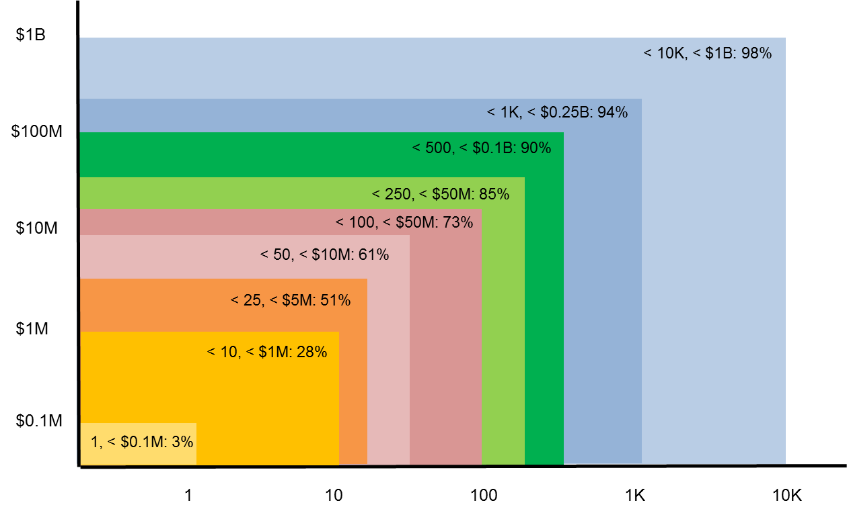
DIB Company Characteristics
Percent of DIB companies in DCMA data set with < 10K employees and < $1B in annual revenue: 98%
Business Annual Revenue
Business Size (Number of Employees)
DCMA data set indicates that small businesses represent vast majority of DIB sector
Notes:
Using the cumulative sum from the joint statistics of annual revenue and number of employees, we can see that the majority of companies fall into a small business category. Most definitions of small business include less than 1000 employees, and when combined with a figure of $250M, we can see that 94% of companies fall under the small business category.

Slide 15
DIB Cybersecurity Posture
State-of-the-Art
  Maneuver, Automation, SecDevOps
Nation-state
  Resourcing: Infosec dedicated full-time staff ≥ 4, Infosec ≥ 10% IT budget
  Sophisticated TTPs: Hunt, white listing, limited Internet access, air-gapped segments
  Culture: Operations-impacting InfoSec authority, staff training and test
Good cyber hygiene
  NIST SP 800-171 compliant, etc.
  Consistently defends against Tier I-II attacks
Ad hoc
  Inconsistent cyber hygiene practices
  Low-level attacks succeed consistently
Hypothesis:
< 1% of DIB companies
Vast majority of
DIB companies

Slide 16
Cybersecurity Maturity Model Certification (CMMC)
The DoD is working with John Hopkins University Applied Physics Laboratory (APL) and Carnegie Mellon University Software Engineering Institute (SEI) to review and combine various cybersecurity standards into one unified standard for cybersecurity.
The new standard and maturity model will be named Cybersecurity Maturity Model Certification (CMMC)
The CMMC levels will range from basic hygiene to “State-of-the-Art” and will also capture both security control and the institutionalization of processes that enhance cybersecurity for DIB companies.
The required CMMC level (notionally between 1 – 5) for a specific contract will be contained in the RFP sections L & M, and will be a “go/no-go decision”.
The CMMC must be semi-automated and, more importantly, cost effective enough so that Small Businesses can achieve the minimum CMMC level of 1.
The CMMC model will be agile enough to adapt to emerging and evolving cyber threats to the DIB sector. A neutral 3rd party will maintain the standard for the Department.
The CMMC will include the development and deployment of a tool that 3rd party cybersecurity certifiers will use to conduct audits, collect metrics, and inform risk mitigation for the entire supply chain.

Slide 17
Questions

