Slide 1
The ASNE Way Ahead Presented to the Tidewater Section
Mark Hugel

Slide 2
The State of the Society
The Society has a highly respected reputation with a core of committed volunteers.
The Financial health of the Society is stable.
The sale of the Duke Street HQ and purchase of the Powhatan Street HQ are behind us and the HQ staff is moving into Powhatan Street as we speak.
The Society Symposia are being well attended and are making or exceeding budget predictions;
but we are only one or two badly run Symposia from toppling our stable financial situation.
The Sections Committee is well organized and speaking up at the national level as advocates for local efforts and support.
Membership is slowly declining.
Sections are generally being sustained by a minority of active members.

Slide 3
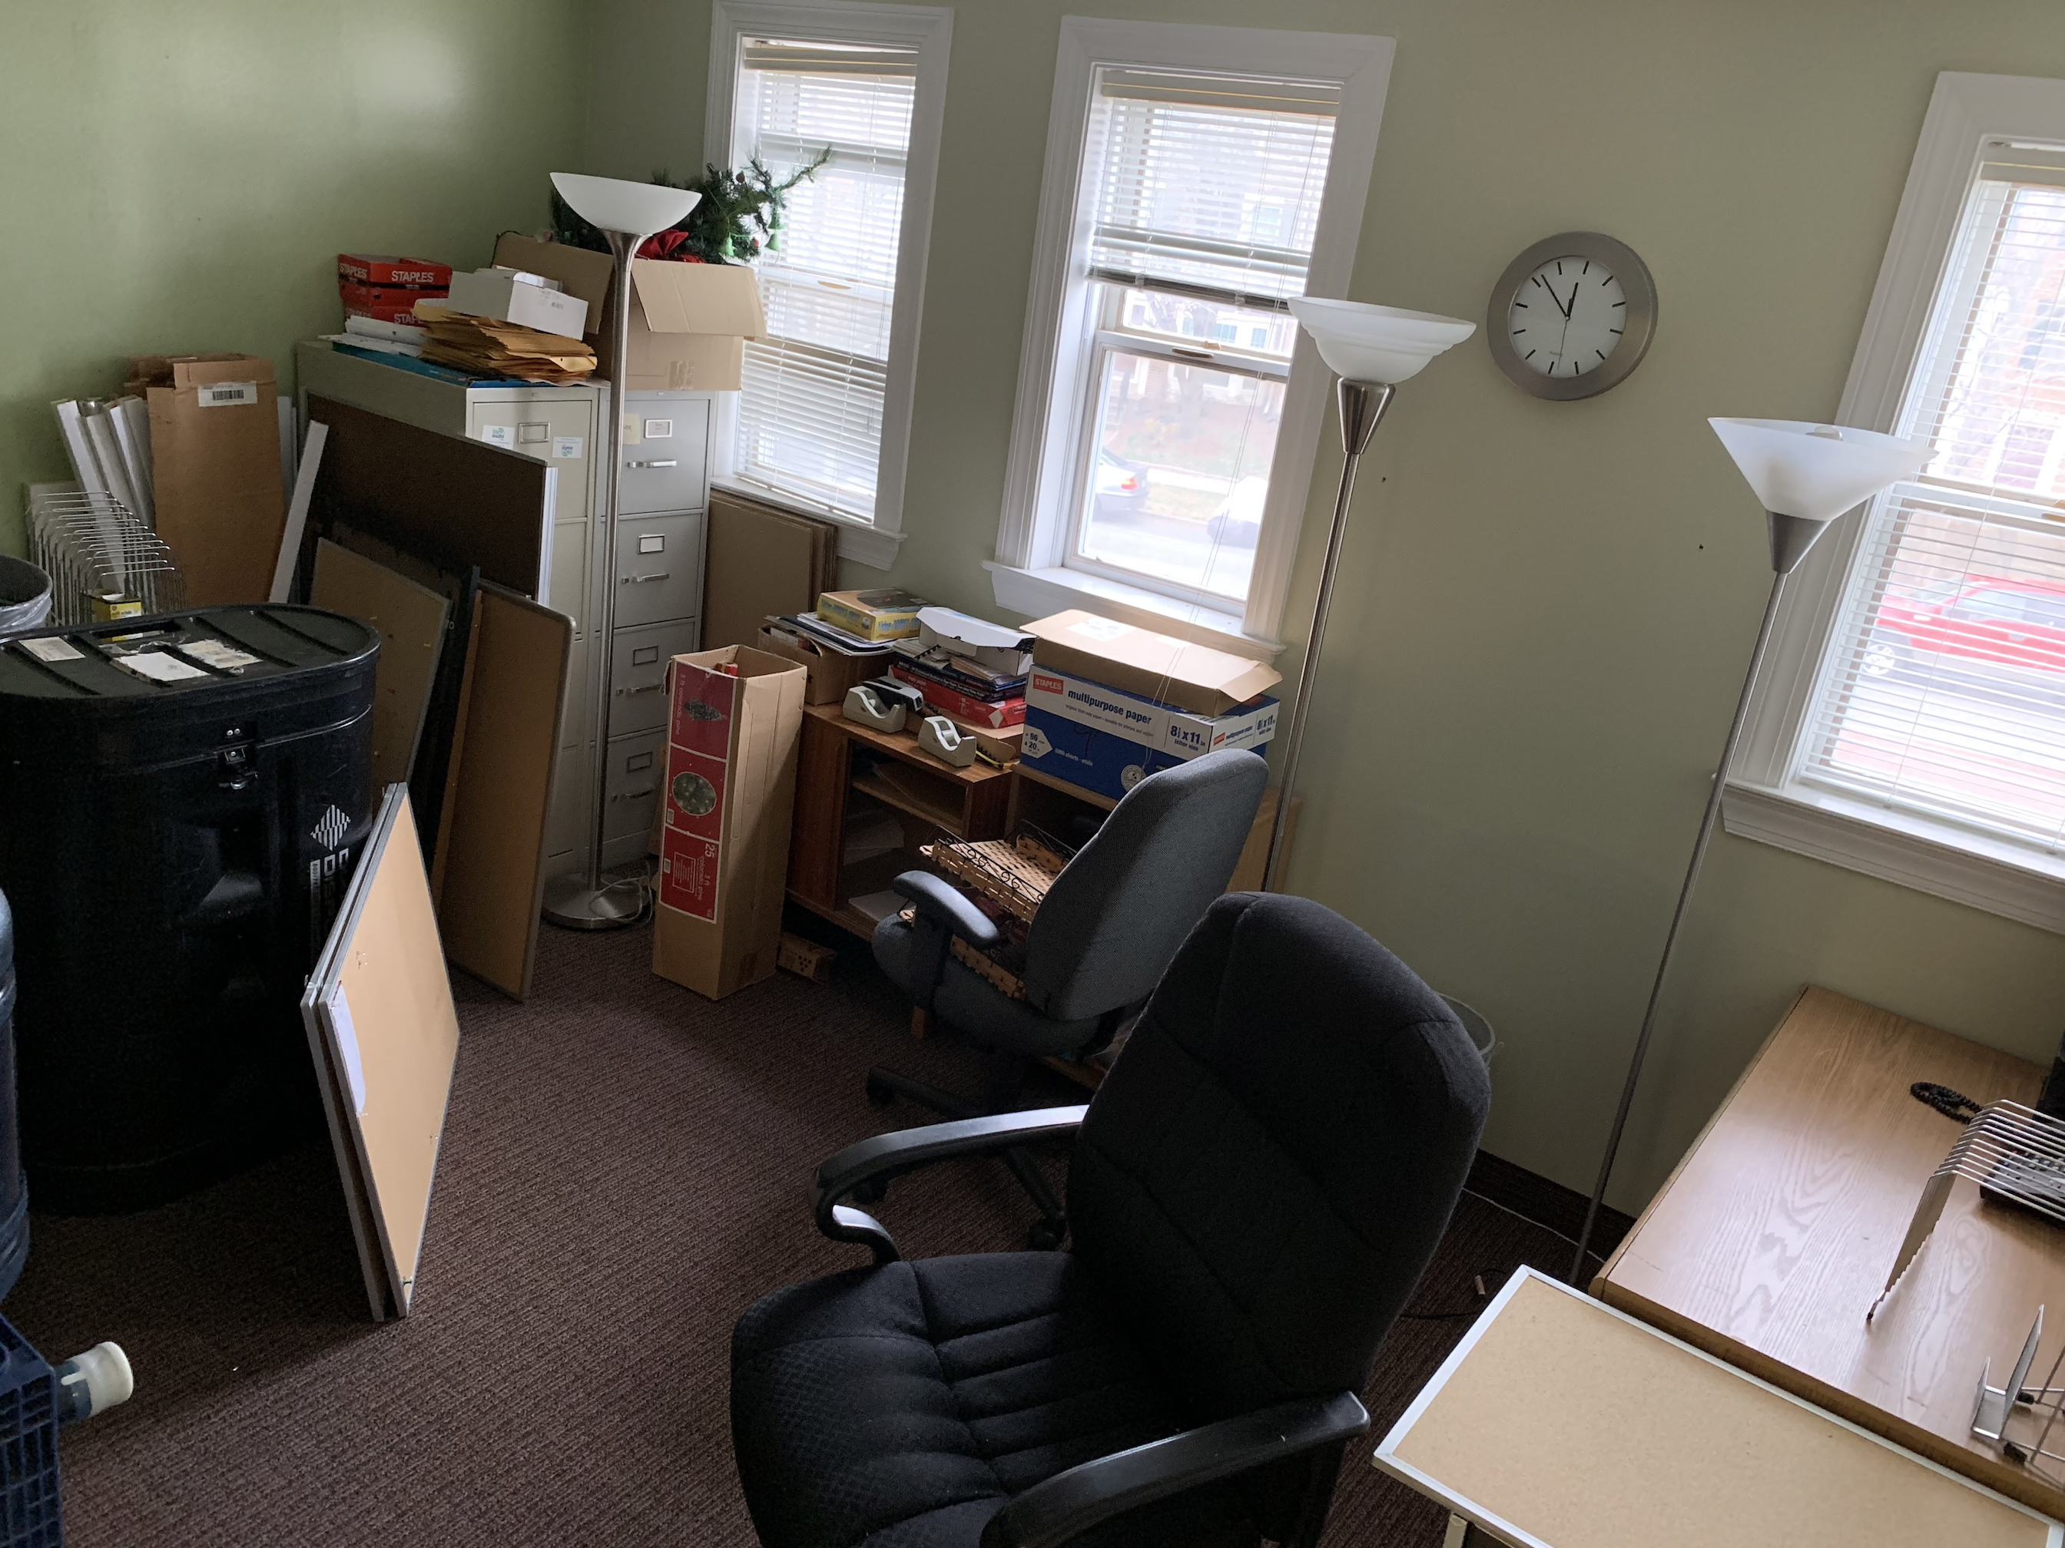
New ASNE HQ (before)

Slide 4
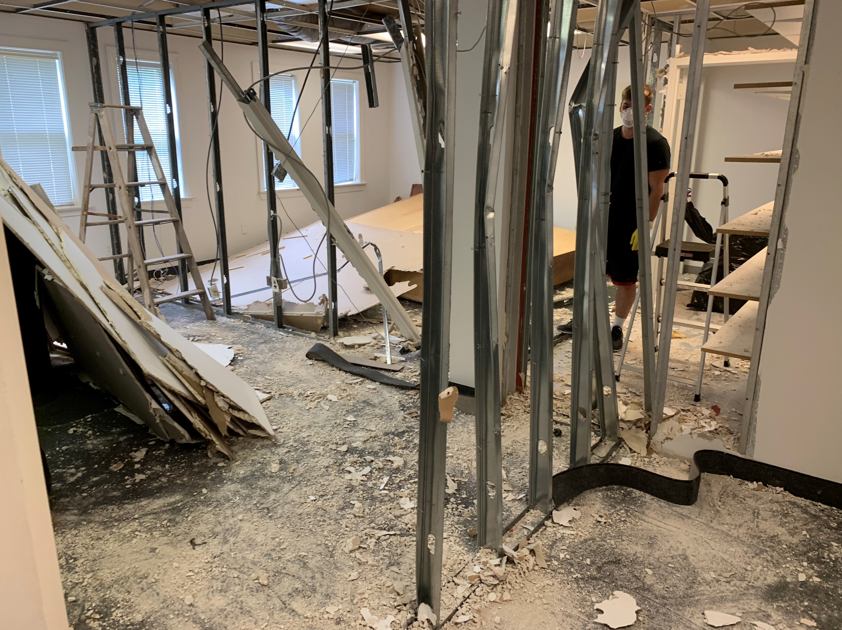
New ASNE HQ (during)

Slide 5
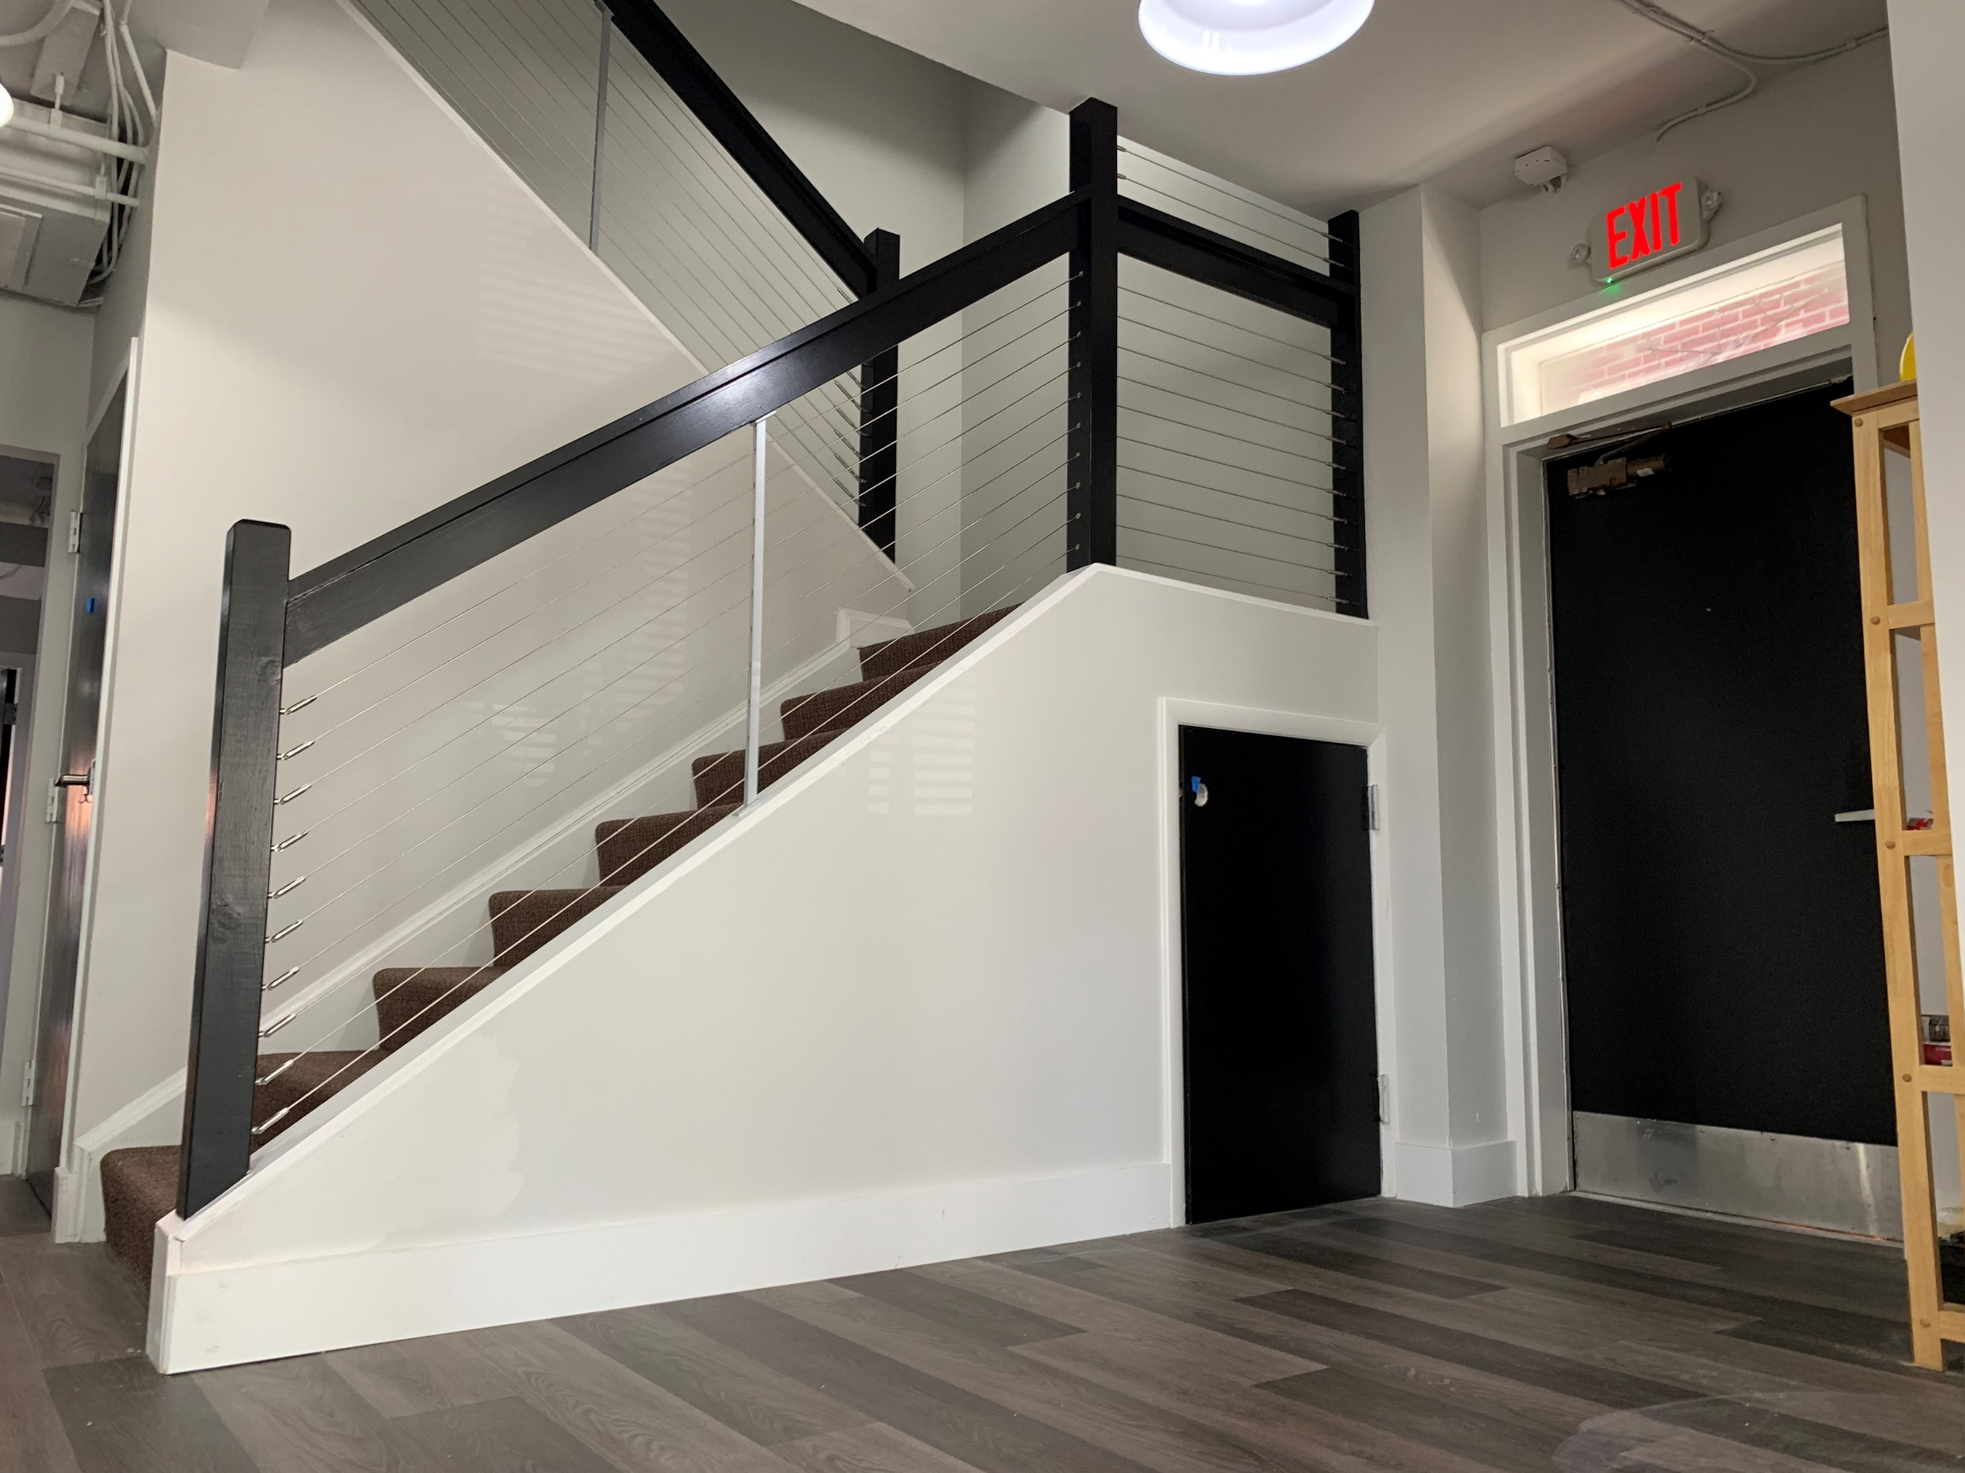
New ASNE HQ (after)

Slide 6
And Now For What Lies Ahead – Tackling Participation
1. How do we increase participation by the current naval engineering leaders (Flag Officers, active duty naval engineers including the Navy’s engineering duty officer community, civil servants, industry experts and others) and perhaps more importantly, the next generation of naval engineers (especially students)?
2. Increased participation is likely to be felt first at the local level since that is where the most regular opportunity to participate in Society activities occurs. What can we do to grow local participation?
3. If we agree the key to increasing Society participation is by stimulating local participation, then what help do the Sections need from the national level?
4. There are “naval engineer concentration areas” where currently no local ASNE presence exists; ASNE Sections could thrive in those areas under good local leadership – where are those locations and who are the leaders we need to encourage and support to create/recreate these opportunities?

Slide 7
And Now For What Lies Ahead – Tackling Membership
5. Are we taking advantage of the opportunity to create and foster good relationships with local universities? Making the local connection to (naval) engineering students offers an opportunity to get them interested and involved.
6. We tend to have good participation from industry – can our local industry partners help us connect with their younger employees, enabling us to demonstrate the relevance of Society participation to their career development?
7. Are we using social media effectively to share local stories of interest or advertise upcoming events?

Slide 8
Standing By for your Questions and Ideas

