Slide 1

American Society of Naval Engineers
Tidewater Section
“Revolutionizing Readiness”
RDML Paul Spedero
Fleet Readiness Officer (N02R) USFFC
22 January 2020

Slide 2
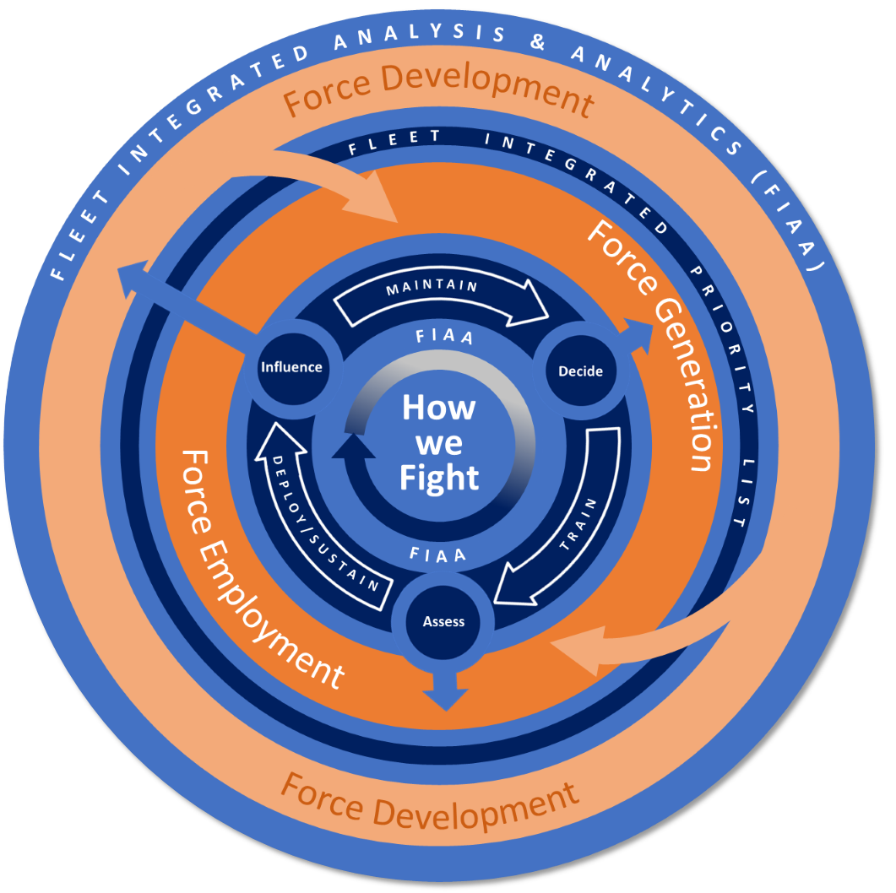
Revolutionizing Readiness
“We need some fundamental changes in how we approach readiness, how we generate it, analyze it, measure it, integrate it, articulate what we need, and predict what the return on our readiness investment might be” – ADM Grady (AFCEA West, Feb 19)
Revolutionize Readiness Campaign
  1 of 5 USFFC Lines of Effort
  One year of effort to date
Fleet Integrated Readiness and Analysis Office and Fleet Readiness Officer (FRO), Nov 2019
  Drive Navy-wide, centrally-managed data governance, and develop USFFC staff analysis and analytical skills
  The FRO will serve as the single Force Readiness (F_{r}) authority
Data analytics to integrate the seams in and across:
Force Development (F_{d})
Force Generation (F_{g})
Force Employment (F_{e})
Articulate the holistic picture of readiness across all phases that measures not just readiness outputs but also the health of the readiness production and capability development cycle with
Force Readiness (F_{r})

Slide 3
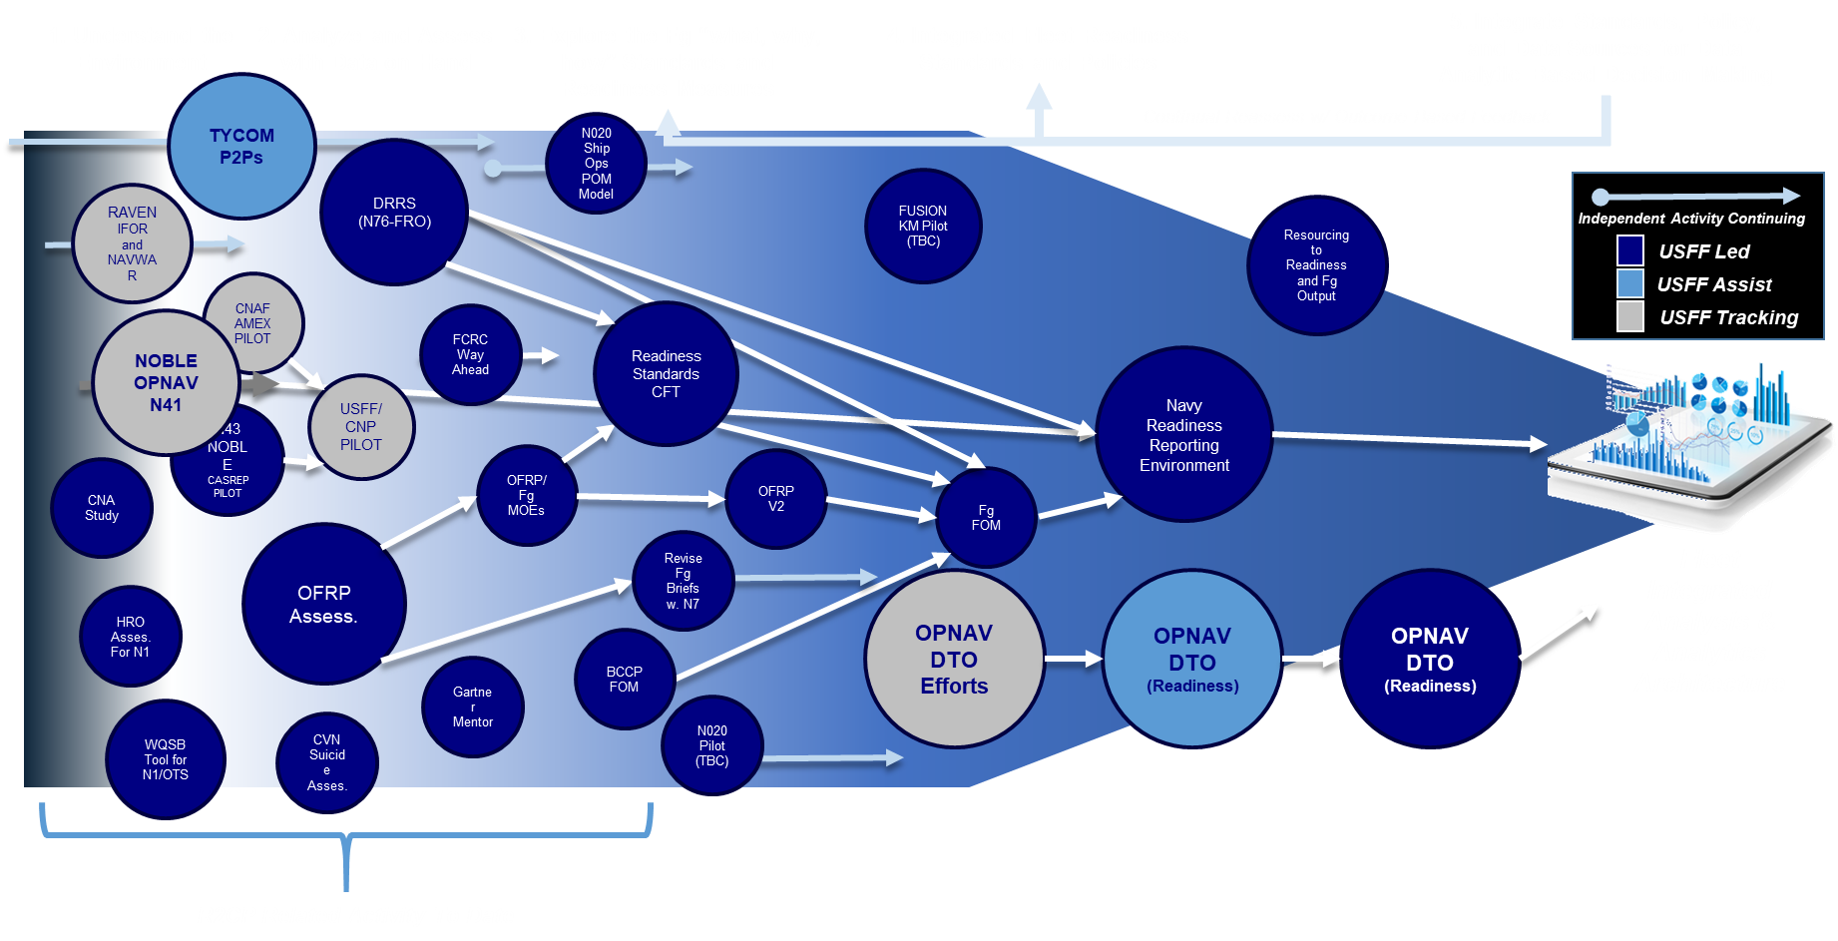
Our Campaign Today: Bringing it Together
Notional Illustration of Integration of Analytic Activity at USFFC to End State

Slide 4
Short-Term Initiatives
Initiative #1
Develop an automated tool to facilitate Operationalize the Staff (OTS) execution by tracking staffing positions, billets, and training across various operating conditions to support Maritime Operations Centers
Initiative #2
Assess performance of the Baseline Configuration Control Plan (BCCP) in developing integrated, interoperable warfighting capabilities delivered to strike groups
Initiative #3
Initiate cross PESTONI-pillar data analytics to improve material readiness through a pilot of the Agile Warfighter Analytics Readiness Environment (AWARE) in the Navy Operational Business Logistics Environment (NOBLE) Systems of Systems (Naval Operational Supply System, Naval Aviation Maintenance System, Naval Operational Maintenance Environment).

Slide 5
Long-Term Goals
Example #1
The ability to integrate readiness data with financial data to seamlessly and agilely assess and visualize a predictive and prescriptive readiness outcome for a given resource investment
Example #2
The ability to dynamically, and in real time assess readiness output with variable time and tempo schedule and force structure demands with an assessment of resulting downstream impacts to the health of readiness production to generate the next force, reset, etc.
Example #3
The ability to predict a unit’s training proficiency at certification based on assessing environmental factors (such as days since last employment, manning risk factors, expected gains or losses) therefore allowing the development of a tailored training plan vice a “one size fits all” approach

Slide 6
Closing Comments
Combat-ready ships
  Relentless on Force Readiness (F_{r})
  Self-sufficiency
  Stay in the fight
Battle-minded crews
  Mission command
  Warfighting culture
  Foundry support

